Slide 1

Music Genre Classification Using Logistic Regression, KNN and PCA+KNN
Roxanne Moe

Slide 2

Problem and Dataset
Goal: Predict the top-level genre of a music track from precomputed audio features.
Dataset: Free Music Archive (FMA) metadata and feature tables.
Files Used: tracks.csv, genres.csv, and features.csv.
Final working subset: 6,746 tracks, 8 genres, 518 features.
Genres Used: Hip-Hop, Pop, Rock, Experimental, Folk, Jazz, Electronic, Soul-RnB.

Slide 3
Methods
Logistic Regression
KNN
PCA + KNN
Linear multi-class baseline
Predicts genre using nearest neighbors in feature space
Proposed hybrid method using PCA before KNN to reduce dimensionality.
Motivation for PCA + KNN: KNN can struggle in high-dimensional spaces.

Slide 4
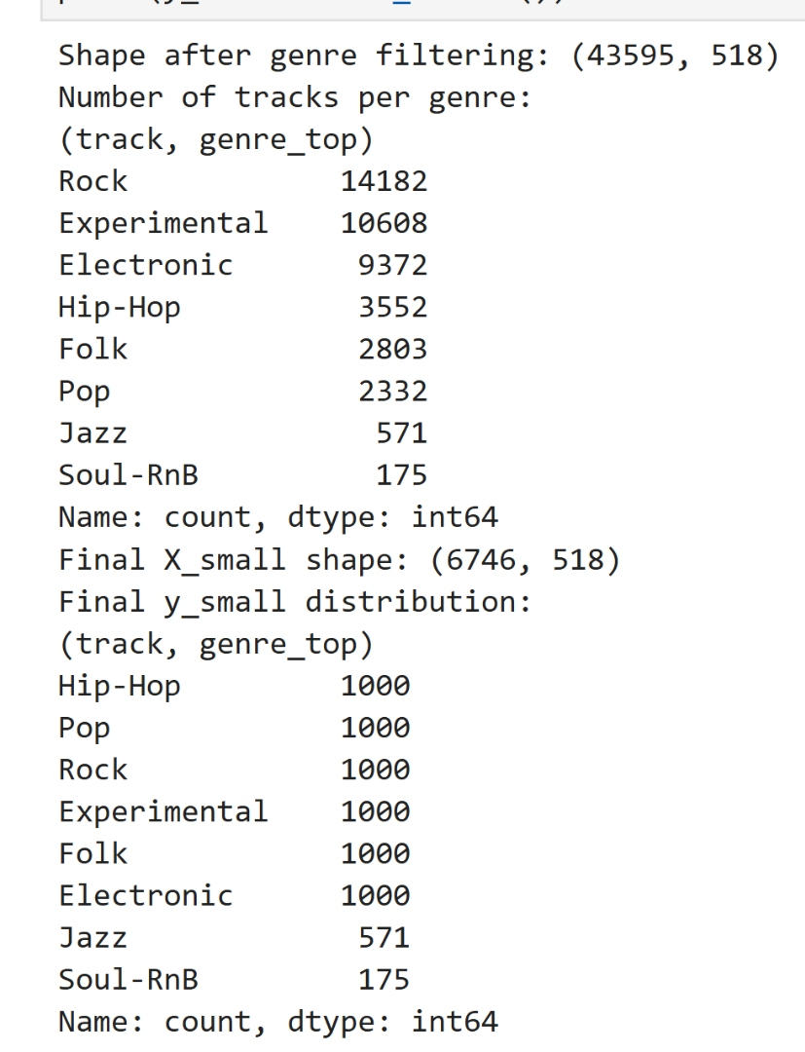
Experimental Setup
80/20 stratified train-test split.
StandardScaler applied in pipelines for fair comparison.

Slide 5
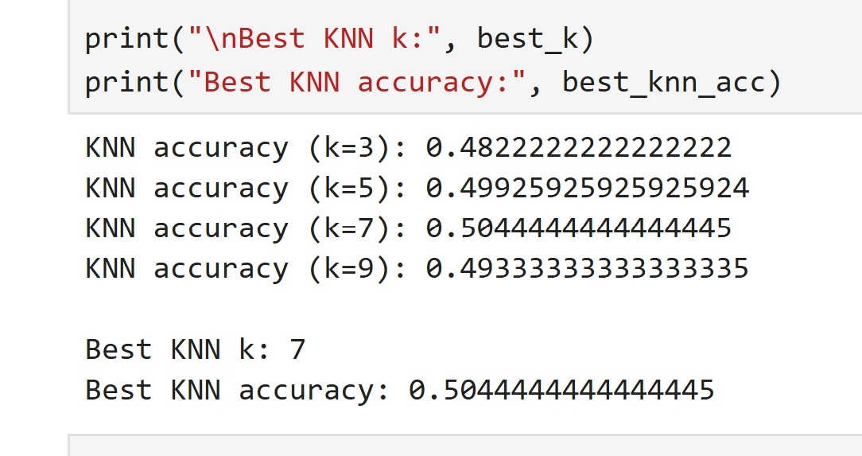
Experimental Setup
KNN test ed with k = 3, 5, 7, 9.

Slide 6
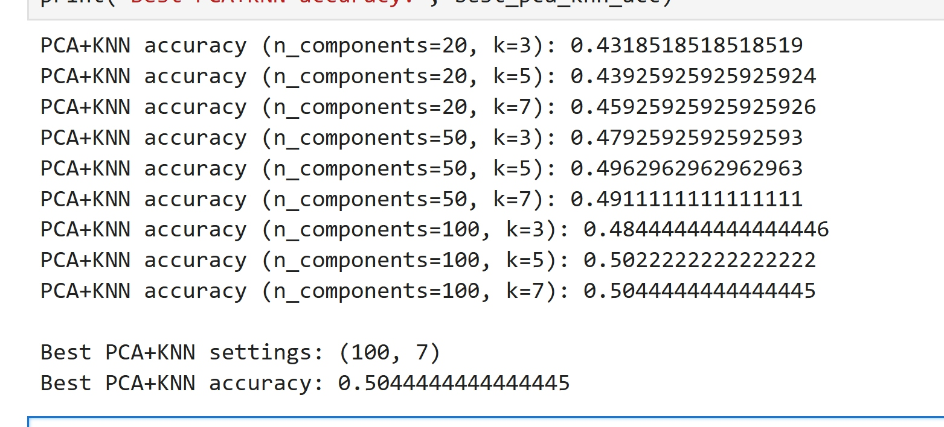
Experimental Setup
PCA + KNN tested with 20, 50, and 100 components; k = 3, 5, 7.

Slide 7
Results
 | Best Setting | Accuracy
Logistic Regression | Default multinominal setup | 0.5319
KNN | k = 7 | 0.5044
PCA + KNN | 100 components, k = 7 | 0.5044
Logistic regression performed best overall.
PCA + KNN matched KNN but did not improve on it.

Slide 8
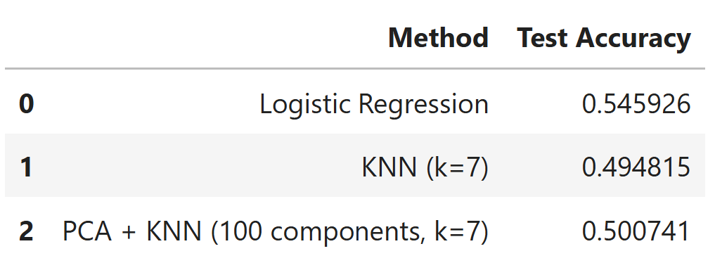
Conclusion
Linear logistic regression worked bettern than local neighbor-based methods on this feature set.
PCA + KNN was a resonable proposed impreovement, but it did not outperform KNN.
Try SVM or random forest.
Use per-class precision/recall and confusion matrices.
Explore spectrogram-based or deep learning approaches.
Future Work

Slide 9

Thanks

